Slide 1
OLIST STORE DATA ANALYSIS

Slide 2
INDEX
Introduction
Tools used
Weekend Vs Weekday payment
Total order by credit card with review score 5
Average number of days taken to order delivered for pet shop
Average price and payment values for customer Sao Paulo City
Review Score wise shipping days
Payment types wise customer
Order wise top 5 city
Excel Dashboard
Power-BI Dashboard
Tableau Dashboard
Challenges
Overcome

Slide 3
Introduction
By analyzing this dataset, we aim to understand the performance of the Olist store, identify trends and extract valuable insights to drive business growth and improve overall efficiency.
The project involve exploring different aspects of the e-commerce domain, such as customer review , growth of sales , product popularity, seller performance and more..
Through this Olist Store Analysis project, we hope to uncover valuable insight that can contribute to better decision making, Operational effciency,Customer Satisfaction.
The finding could potentially guide marketing strategies, inventory management, Sellers on boarding & other crucial aspect of the ecommerce business.

Slide 4

Tools used for Analysis

Slide 5
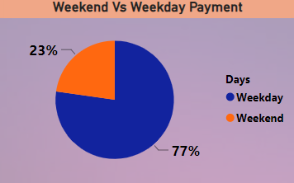
KPI_1- Weekend VS Weekday payment statistics
Observation :-
1 :The payment done in weekday is 77% and weekend is 23% , which is representing highest payment on weekday as compared to weekend.
2 : The weekdays payment is 3.4 times of weekend payment.
Conclusion :-
1 : Businesses can optimize their strategies to capitalize on higher payment volumes during weekdays, while also considering targeted approaches to boost weekend payments.
2 : To increase the weekend sales we can release any special offers on the weekends .Which helps to generate more revenue.
3 : Analyzing weekdays versus weekends enables customer segmental on allowing for personalized marketing approaches to reach customers effectively on the days when they are more likely to make purchases.

Slide 6

KPI_2 → Number of Orders with review score 5 and payment type as credit card
Observation:-
1:With a review score of 5 and payment type as a credit card, highest order has been received .
2: More than 70% of sales were paid by Credit Card which is increasing customer satisfaction also.
Conclusion:-
1:The prevalence of credit card payments and high review scores reflects positive customer experiences.
2:The high number of orders signifies a strong demand for the products or services offered.
3:Company can tie-up with any bank for promoting credit-card in shop.
4: Credit card’s use open provides an added layer of security and protection against fraud. Customers may perceive the Olist Store as reliable and trustworthy and conveniently use their credit cards, resulting in higher review scores

Slide 7

KPI_3 →Average number of days taken to deliver order for pet shop
Observation:
1: 11 days is the avg days taken to deliver the order for pet shop.
Conclusion:
1: The observation highlights the need for streamlining processes and improving operational efficiency at the pet shop.
2: Enhancing efficiency can lead to shorter waiting times for customers and increased satisfaction.
3: Identifying bottlenecks or inefficiencies in the work flow can help the pet shop streamline operators, reduce delays, and improve overall productivity

Slide 8
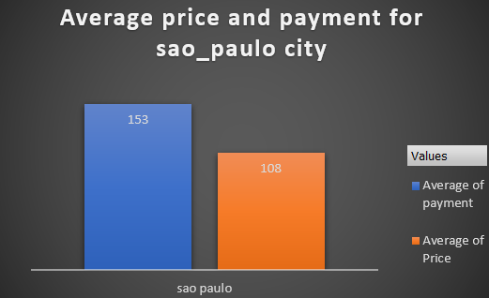
KPI_4 → Average price and payment values from customers of sao paulo city
Observation:-
1:The payment is more as compared to price of the product.
2.Customer paying 41% extra for products.
Conclusion:-
1: The highest payment value compared to price suggests that consumers in São Paulo City are willing to spend more than the average price for goods or services.
2: This observation may indicate a relatively affluent consumer base or a preference for higher-end products or services in the city.
3: To increase sales on other cities we can work on faster delivery and easy payment modes and product wise offers.
4: Emphasize quality, unique features, or superior customer service to justify the higher prices and enhance customer satisfaction.

Slide 9
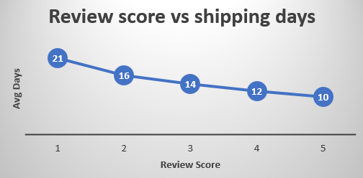
KPI_5 → Relationship between shipping days Vs review scores.
Observation:-
1:Less shipping days is having highest review score.
2:Highest shipping days is having less review score.
3: customer satisfaction is based on shipping days.
Conclusion:-
1: The observation suggests a correlation between shipping efficiency and customer satisfaction levels.
2: Businesses that can deliver orders more quickly tend to receive higher review scores, indicating greater customer satisfaction.
3: Optimizing shipping processes and reducing shipping times may lead to improved customer experiences and higher satisfaction levels

Slide 10
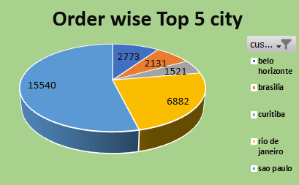
KPI_6 Order wise Top 5 city
Observation:
1: Sao Paulo city is having highest order where Curitiba city is having lowest order as compared to other city.
Conclusion:
1:Some offers can be promoted for other cities to increase the order quantity.
2: Brasília and Curitiba have comparatively lower order volumes but still contribute significantly to overall orders.

Slide 11
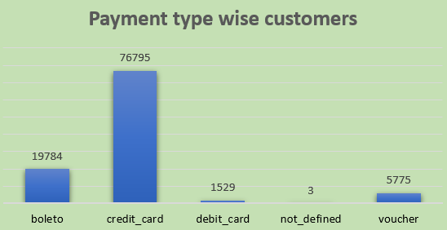
KPI_7 Payment type wise customer
Observation:
1: Customers predominantly use credit cards for payments.
2: More then 75% of payment made through Credit Card.
Conclusion:
1: Credit cards are the preferred payment method among customers, indicating a preference for convenience payment options.
2: Boleto payments, while less common than credit cards, still represent a significant portion of transactions, suggesting a preference for cash-based transactions or concerns about security.
3: The usage of debit cards and vouchers is comparatively lower, indicating less popularity among customers.

Slide 12
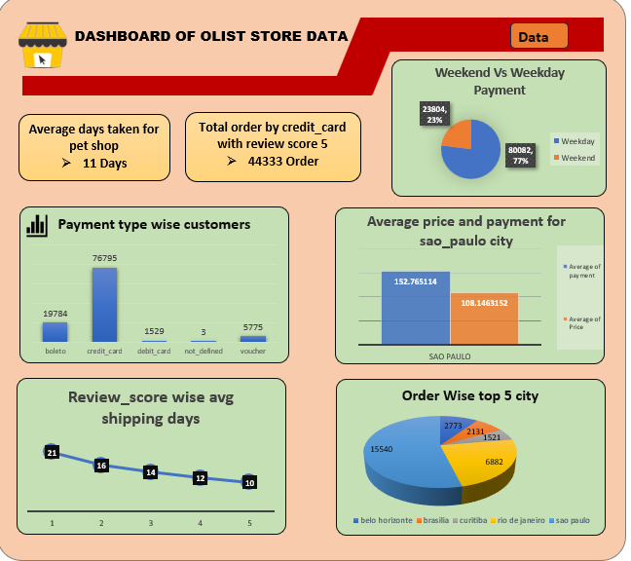
Excel Dashboard

Slide 13
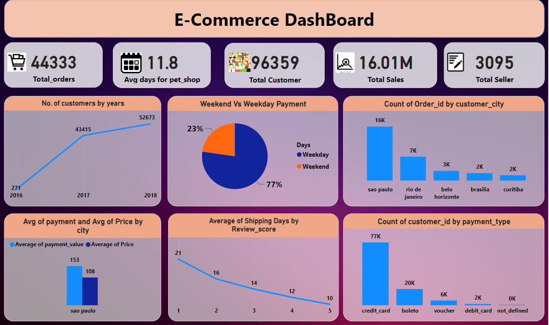
Power Bi Dashboard

Slide 14
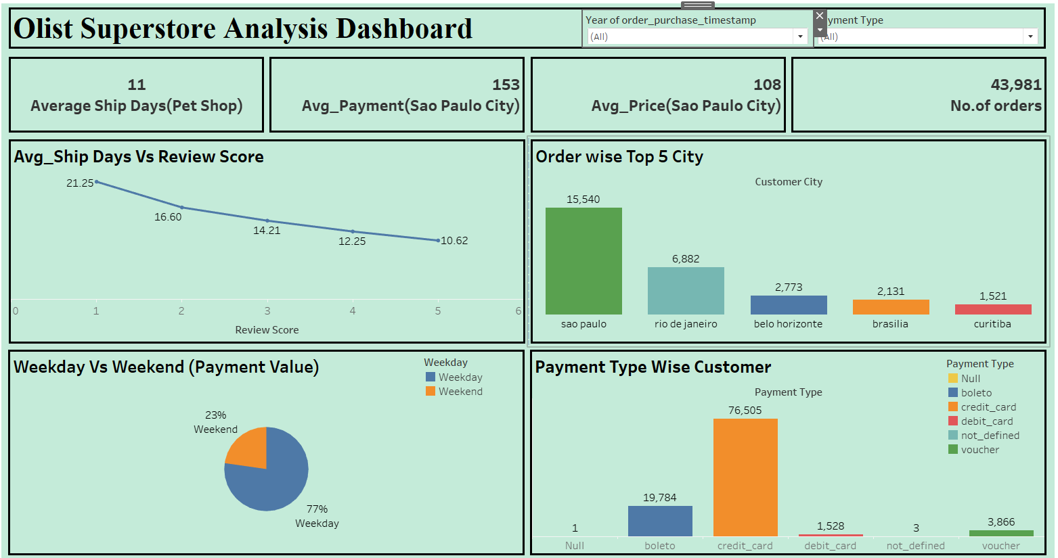
Tableau Dashboard

Slide 15
Challenges:-
1.Excel-
#Data importing in excel is difficulty due to huge quantity.
#In excel we cant use more advanced visualisation of data.
#Slow files that keep crashing
2.SQL-
#Difficulty in importing data because its taking limit in direct import is 1000 rows.
#Writing complex queries is difficult.
3.Power BI-
#Taking more time to load data sheet.
#importing data through SQL is very difficult.
#If reports are not optimized, there is a risk of errors in the displayed data
4.Tableau-
#Data co-relation is difficult.
#Complex schema due to large data sheet.
#difficult in complex calculation.
Overcome:-

Slide 16
Over come
Using Power query.
Creating Table then importing data.
Rechecking queries.
Checking with each table for joining and identifying column name to join.

Slide 17



